Slide 1
SUMMER INTERNSHIP - 2026
AI Agents for Digital Capability Building in Tata Steel
WEEK-4
Make It Intelligent (Data + Context + Scale Thinking)
Under The Guidance of:
Mr. Abhinav Anish
Submitted By: Vaibhav Kumar

Slide 2
From Demo to Real-World Solution
Transitioning From Demo to Production
In Week 4, the primary goal was upgrading the simple prototype chatbot into an enterprise-ready, context-aware digital learning assistant. We integrated real and simulated company documents, implemented safety access controls, and improved query retrieval quality.
💡 Mentor Push: "Would you trust this AI in a real training environment?" To meet this standard, we targeted zero-hallucination vector searches, robust RBAC safety blocks, and 100% accurate contextual grounded Ness.
1. Domain-Specific RAG Database
Indexed leave, onboarding policies, safety codes, bearing manuals, NSDC roles, and Tata reports into separate, dedicated vector collections.
2. Context-Aware Personalization
Integrated SQLite DB containing employee profiles (name, current/target role, readiness score) to tailor learning recommendations instead of generic advice.
3. Robust Guardrails & RBAC Security
Introduced strict user types (Employee, Manager, etc.) to block access to production data, returning professional block warnings instead of unauthorized info.

Slide 3
Multi-Agent System Architecture
Central Orchestrator
Classifies query intent (KNOWLEDGE, HR, MAINTENANCE, LEARNING, PRODUCTION).
Enforces RBAC access control matching user types.
Knowledge & SOP Agent
RAG: Searches safety manuals, NSDC roles, annual and sustainability reports.
Utilizes query expansion fallback.
Specialist Agent Orchestration
Instead of a single large LLM prompt, we deployed five specialized, dedicated agents coordinated by a central Orchestrator. This ensures separation of concerns, high accuracy, and isolated database contexts.
Orchestrator Routing Flow: 1. User input query received. 2. LLM Intent Classifier classifies category. 3. Role-Based Access Control (RBAC) checked. 4. Routes query to the designated specialist agent. 5. Returns structured answer and verified document sources.
HR Support Agent
RAG: Searches leaves, benefits and policies.
HyDE-lite translation for Hinglish/Hindi, query refinement loop.
Maintenance Agent
RAG: Equipment manuals and codes.
Direct role-name detection, tiered fallback searching.
L&D Learning Agent
SQL: Directly queries SQLite database.
Extracts readiness score, missing skills, lists courses, dynamic tasks.
Production Agent
SQL: Aggregates downtime and KPIs from DB.
RBAC restriction: Restricted to Managers and Executives.

Slide 4
Specialist RAG Agents & Design Rationale
Knowledge & SOP Agent
Scope: Company policies, SOPs, safety manual, annual reports, NSDC roles.
Architecture Highlights:
• Targeted Collections: Maps keywords to target specific collections, preventing cross-domain overlap.
• Query Expansion: If the initial query returns no matches, an LLM rewrites the query with synonyms/financial terminology.
• Clean Source Reporting: Only lists PDF sources if the final generated response actually utilized the context.
HR Support Agent
Scope: Leaves, payroll, onboarding, probation, benefits, HR policies.
Architecture Highlights:
• HyDE-lite Query Translation: Translates input query to English for embedding search to match English documents.
• Output Match: Responds in the exact input language (Hindi, English, or Hinglish) using tailored prompts.
• Sufficiency Check: Employs a self-RAG LLM sufficiency check; expands and retries if context is lacking.
Maintenance Agent
Scope: Machine vibration, sensor alerts, LOTO procedures, bear operating range.
Architecture Highlights:
• Tiered Search Flow: Searches specific `maintenance` collection first. If empty, falls back to `role_knowledge` collection.
• Role Matching: Scans the query for specific plant roles (e.g. Heating Regulator) and filters search to that metadata field.
• Help Desk Escalation: Falls back to Maintenance Supervisor (Ext. 301) for unmentioned safety procedures.

Slide 5
Database-Connected SQL Agents
L&D Learning Agent
Objective: Access personalization and training career roadmaps.
Architecture & Implementation Details:
• Database Integration: Gathers data from SQLite `users`, `skill_gap` and `recommendations` tables using user_id.
• Personalized Context: Extracts user metrics like Experience Years, Target Role, Readiness Score, and Missing Skills.
• Dynamic Task Customization: Checks query keywords to customize prompt focus. For example, queries about duration prompt a focus on recommended course durations and priority order.
• Privacy Protection: Restricts recommendations to the logged-in user only, blocking cross-employee data leaks.
Production & KPI Agent
Objective: Provide managers/executives with plant efficiency data.
Architecture & Implementation Details:
• Structured SQLite Queries: Queries Unit KPIs (e.g. Unit 3 underperformance) and aggregates downtime reasons (Raw Material Shortage, Power Outage, Equipment Failure).
• RBAC Access Control: Integrates directly with the central Orchestrator. The orchestrator checks if the current user_type is 'Manager' or 'Executive' before routing to this agent.
• Secure Rejection: If an Employee or New Joiner asks about Unit downtime, the query is blocked, returning a friendly refusal page.

Slide 6
Development Challenges & Solutions (Part 1)
Challenge 1: Multilingual Retrieval Performance
Problem:
Ground-level plant technicians and onboarding employees often search in Hinglish (Hindi written in Roman letters, e.g., 'mujhe kitni casual leave milti hai') or Hindi. Searching directly in English policy documents yielded high vector distances, retrieving irrelevant sections or causing RAG failures.
Mitigation Strategy: HyDE-Lite Normalization
1. Added a translation layer using Llama-3.1-8B.
2. Pre-processed Hinglish/Hindi queries into clear English search queries for vector similarity matching.
3. Conducted the final LLM response generation using the original question, ensuring responses match the input language.
4. Output: Reduced vector distance from 0.56 to 0.29 (47% improvement).
Challenge 2: Cross-Domain Chunk Leakage
Problem:
Vector search across a global database returned unrelated documents due to overlapping keywords. For example, a query about 'welding safety' retrieved HR policy snippets instead of safety manuals because of generic corporate vocabulary.
Mitigation Strategy: Semantic Targeting
1. Reorganized database into separate collections: `knowledge_safety`, `knowledge_reports`, `role_knowledge`, `maintenance`, `hr_support`.
2. The Orchestrator routes the search to specific collections based on classified intent.
3. Role Detection: Matches names (e.g. Heating Regulator) in the query and filters search results accordingly.

Slide 7
Development Challenges & Solutions (Part 2)
Challenge 3: Low Grounded Ness & Hallucinations
Problem:
The agent evaluation report initially showed an Average Grounded Ness/Faithfulness score of just 20.0%. The LLM commonly cited irrelevant PDFs or hallucinated numbers that were not present in the vector DB chunks.
Mitigation Strategy: Self-RAG & Post-Filters
1. Sufficiency Loop: Built a Self-RAG validation check. An LLM judge evaluates if retrieved chunks are sufficient. If not, the query is refined and resubmitted.
2. Deduplication Filter: Deduplicates text blocks, preserving the highest-ranked embeddings to fit clean contexts into the LLM context window.
3. Source Utilization Validator: A prompt filter checks if the LLM couldn't answer from context. If it answers 'not found', it clears the cited PDF sources.
Performance Evaluation Summary
Using LLM-as-a-judge (Llama-3.1-8B-instant) on standard test suites:
• Intent Routing Accuracy: 100.0%
The orchestrator routes KNOWLEDGE, HR, LEARNING, PRODUCTION queries with 100% accuracy.
• RBAC Safety / Block Accuracy: 100.0%
Employees and New Joiners are successfully blocked from accessing sensitive Unit downtime details.
• Answer Relevance Score: 90.0%
Answers directly target the employee's intent.
• Average Answer Correctness: 60.0%
Factual correctness evaluates to 60.0% matching expected ground truth answers.

Slide 8
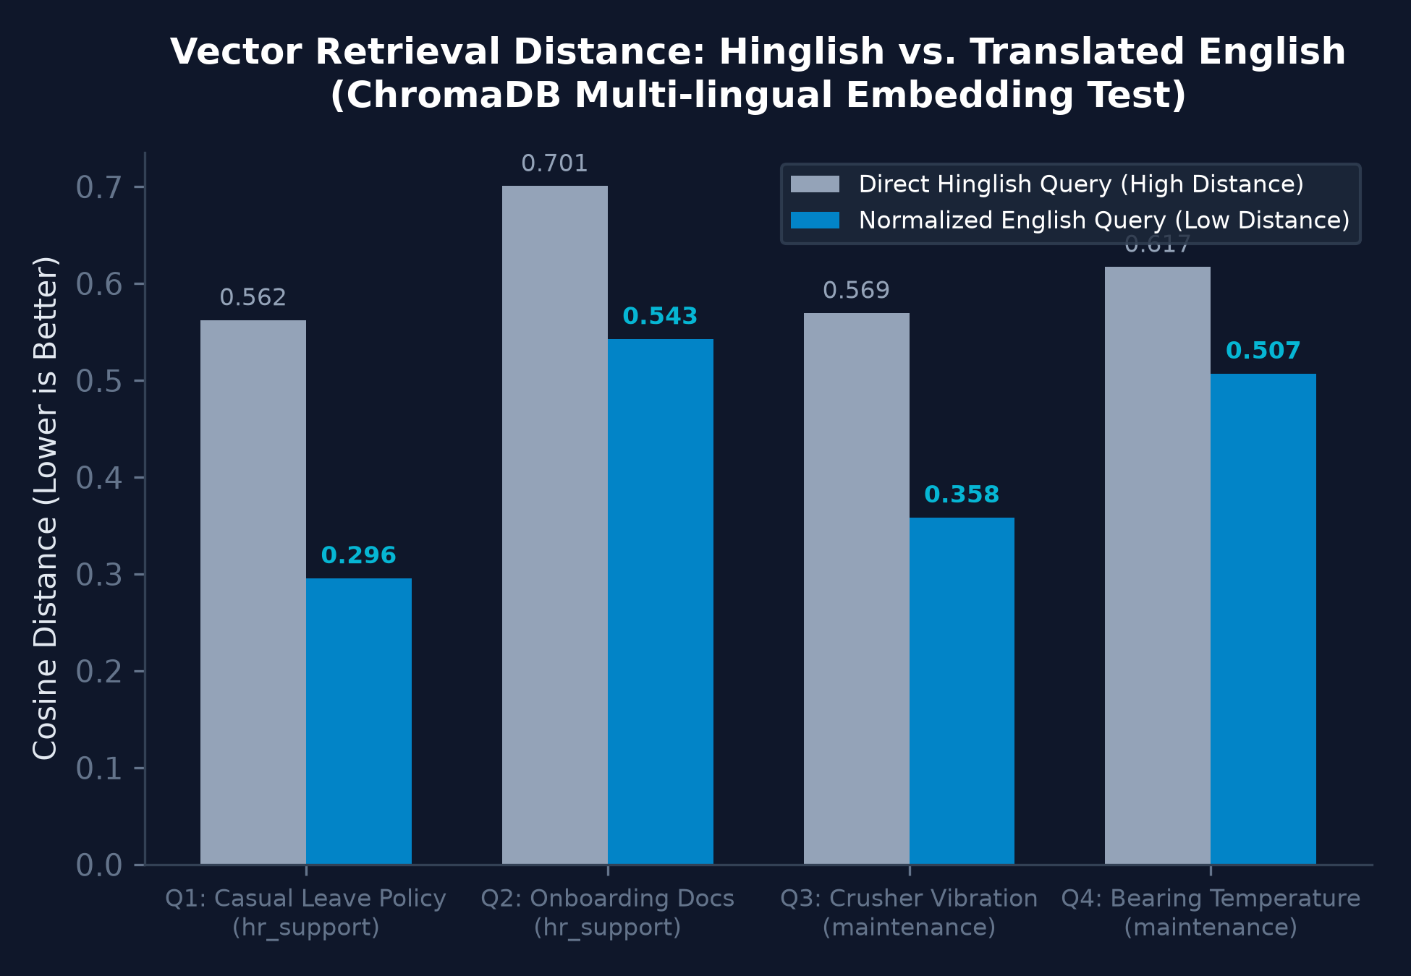
Search Distance Improvements (Hinglish vs English)
Embedding Distance Analysis
When technicians search in their natural Hinglish syntax, the vector model reports high cosine distance (lower similarity) due to English indexing. By translating Hinglish to English before retrieval, the distance drops significantly, bringing relevant chunks to the top of results.
Key Improvements: • Q1: Casual Leaves (Distance reduced by 47.4%) • Q2: Onboarding (Distance reduced by 22.5%) • Q3: Crusher Vibration (Distance reduced by 37.0%) • Q4: Bearing Temperature (Distance reduced by 17.8%) Average improvement across queries is 31.2%, preventing RAG from retrieving wrong files.

Slide 9
Query Flow: Specialized RAG Agents
Knowledge & SOP Flow
1. User Query Received
↓
2. Role Detection: Checks for specific plant roles (e.g. Battery Operator) in query.
↓
3. Collection Targeting: Searches 'role_knowledge' (if role detected), 'knowledge_safety', or 'knowledge_reports' based on keywords.
↓
4. Semantic Search: Queries selected vector DB collections.
↓
5. Fallback Query Expansion: If no chunks hit, LLM expands query with synonyms (annual report, capex, safety) and retries searching all collections.
↓
6. LLM Context Answer: Generates response using context.
↓
7. Source Filter: Removes PDF sources if final answer states info is not found in context.
HR Support Flow
1. User Query Received
↓
2. HyDE-lite translation: LLM translates query (Hindi/Hinglish) into English.
↓
3. Vector Search: Queries 'hr_support' collection using English query.
↓
4. Deduplication: Removes duplicate chunks, keeps top scoring results.
↓
5. Sufficiency Check (Self-RAG): LLM checks if context answers query. If insufficient, refines query and retries.
↓
6. Target Language Matching: Generates final response using original query language (Hindi/Hinglish/English).
↓
7. Output: Combines sources and final multilingual answer.
Maintenance Support Flow
1. User Query Received
↓
2. Role Scanner: Scans for job roles in query.
↓
3. Primary Search: Searches 'maintenance' collection (max distance 0.75).
↓
4. Secondary Fallback: If no results, searches 'role_knowledge' collection filtered by detected role metadata.
↓
5. Deduplication: Removes duplicate paragraphs.
↓
6. Context Synthesis: Merges manual sources.
↓
7. Escalation Fallback: If missing, returns response suggesting Maintenance Supervisor (Ext. 301).

Slide 10
Query Flow: Database-Connected SQL Agents
L&D Learning Agent Flow
1. User Query + User ID Received
↓
2. SQLite Connection: Opens data/database.db connection.
↓
3. Profile Extraction: Queries 'users' table for name, department, current/target role, and experience.
↓
4. Skill Gap Retrieval: Queries 'skill_gap' table for missing skills list and readiness score.
↓
5. Course Retrieval: Joins 'recommendations' and 'courses' tables to pull course names, priorities, durations, and skills taught.
↓
6. Task Classification: Scans query keywords to dynamically focus prompt task (duration focus vs. skill gap focus vs. promotion readiness focus).
↓
7. LLM Formulation: Generates structured, personalized roadmap strictly based on SQLite details.
Production KPI Agent Flow
1. User Query Received
↓
2. Orchestrator RBAC authorization check (Employee/New Joiner vs Manager/Executive).
↓ [Access Denied: Returns access blocked response]
3. Access Granted: Orchestrator routes query to Production Agent.
↓
4. Entity Extraction: Extracts query parameters (e.g. Unit number, departments).
↓
5. SQLite SQL query: Queries database for plant efficiency, sensor readings, and downtime statistics (Raw Material Shortage, Power Outages, Equipment Faults).
↓
6. Data Aggregation: Summarizes production KPIs in clean numeric counts.
↓
7. Response Generation: Outputs factual reports and recommendations.

Slide 11
Knowledge Base Structure & Chunking Strategy
Knowledge Base Collections & Source Files
Our RAG database uses ChromaDB with 5 dedicated collections to prevent cross-domain search contamination:
1. `knowledge_safety` collection
- File: `safety_manual.pdf` (Chemical spills, fire, LOTO, PPE codes)
2. `knowledge_reports` collection
- Files: `tata_annual_report_2025.pdf`, `sustainability_2024.pdf` (EBITDA, capex, ESG parameters)
3. `role_knowledge` collection
- Files: NSDC role outline PDFs (Heating Regulator, Battery Operator, Control Room, etc.)
4. `maintenance` collection
- File: `maintenance_manual.pdf` (Bearing temps, crusher vibrations, PM schedules)
5. `hr_support` collection
- Files: `hr_policy.pdf`, `leave_policy.pdf`,`onboarding_doc.pdf`
Chunk Size & Overlap Strategy Rationale
Chunking configurations are tailored specifically to the structural layout of each file type:
• Safety (Size 250 / Overlap 50 words)
Rationale: Keeps sequential step-by-step procedures unified in a single block without truncation.
• Reports (Size 250 / Overlap 50 words)
Rationale: Captures surrounding financial context and comparisons necessary for dense tables or financial metrics.
• Role Knowledge (Size 200 / Overlap 40 words)
Rationale: NSDC PDFs are bullet-heavy. 200 words captures entire individual competency blocks cleanly.
• Maintenance (Size 180 / Overlap 40 words)
Rationale: Keeps troubleshooting guidelines concise to isolate specific errors and limit noise from other machine manual sections.
• HR Support (Size 120 / Overlap 30 words)
Rationale: HR policies contain short standalone rules (e.g. leave days). Tiny chunks pinpoint rules precisely, preventing leakage.

Slide 12
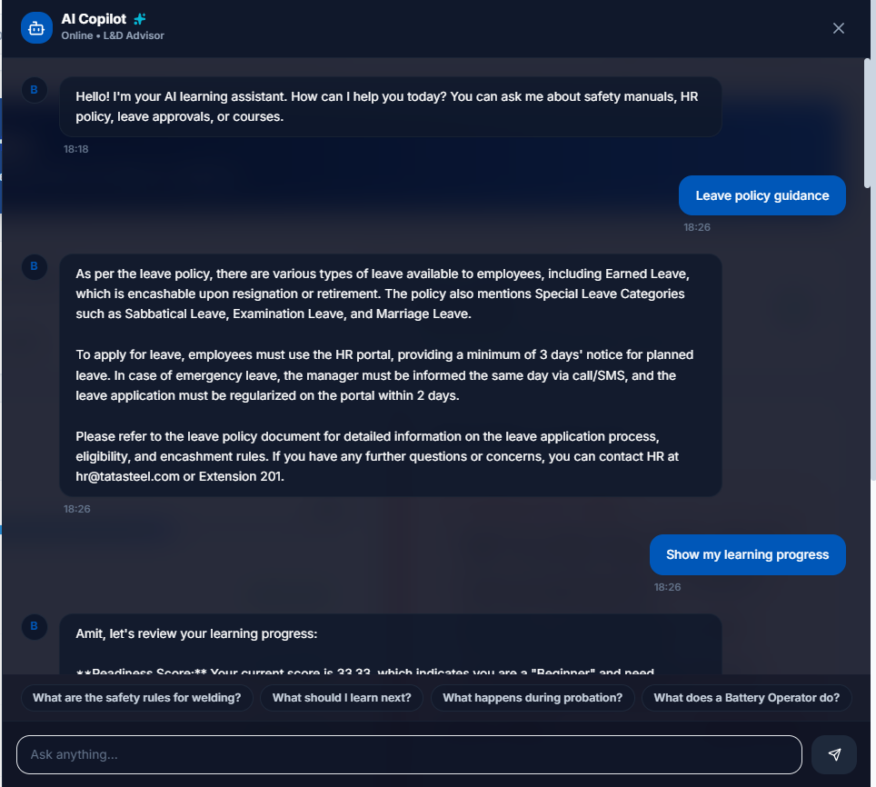
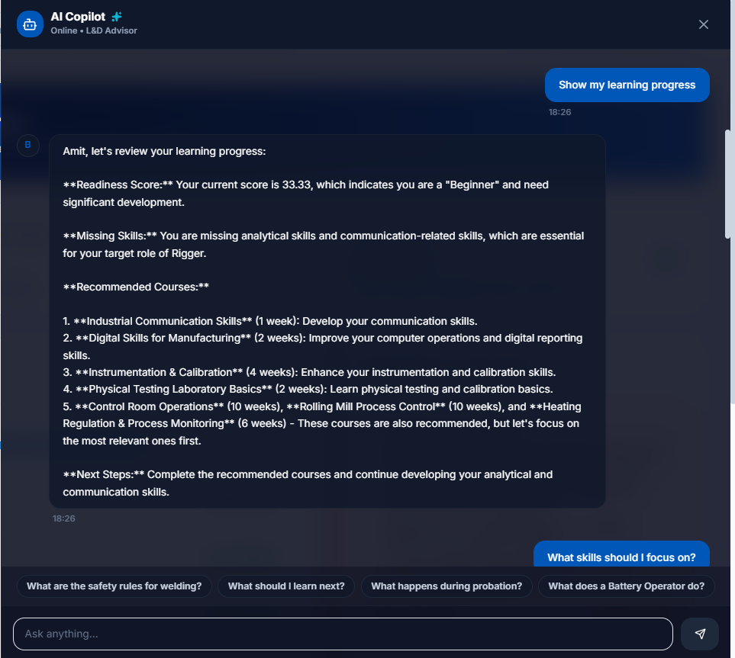
System Demonstration & Screenshots

Slide 13
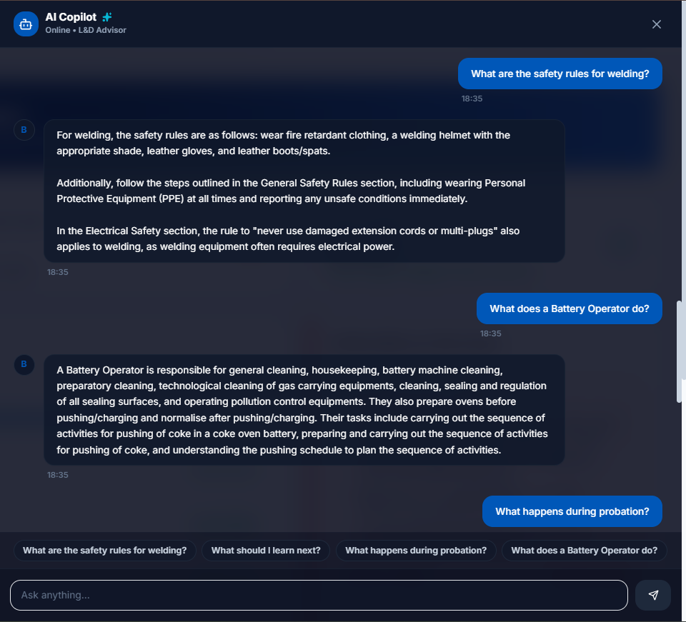
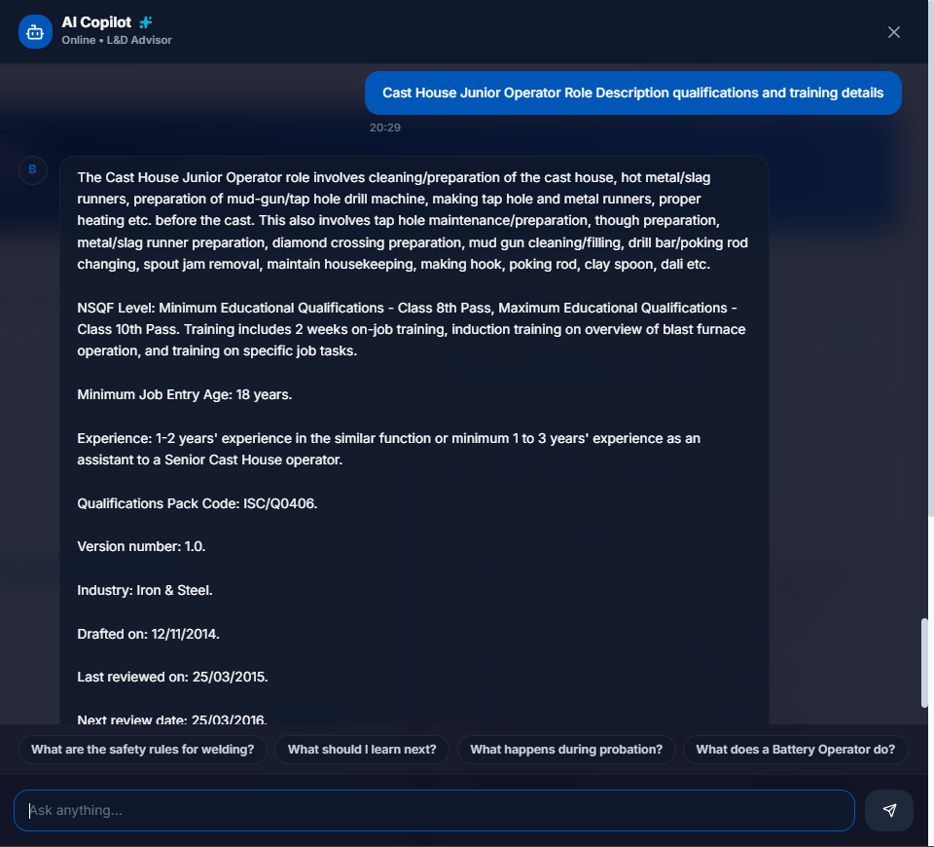
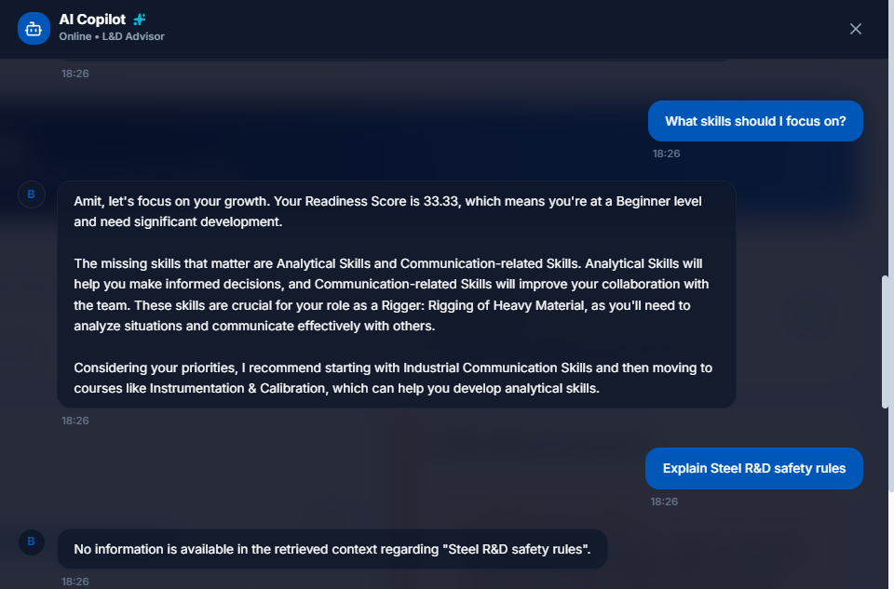
System Demonstration & Screenshots

Slide 14
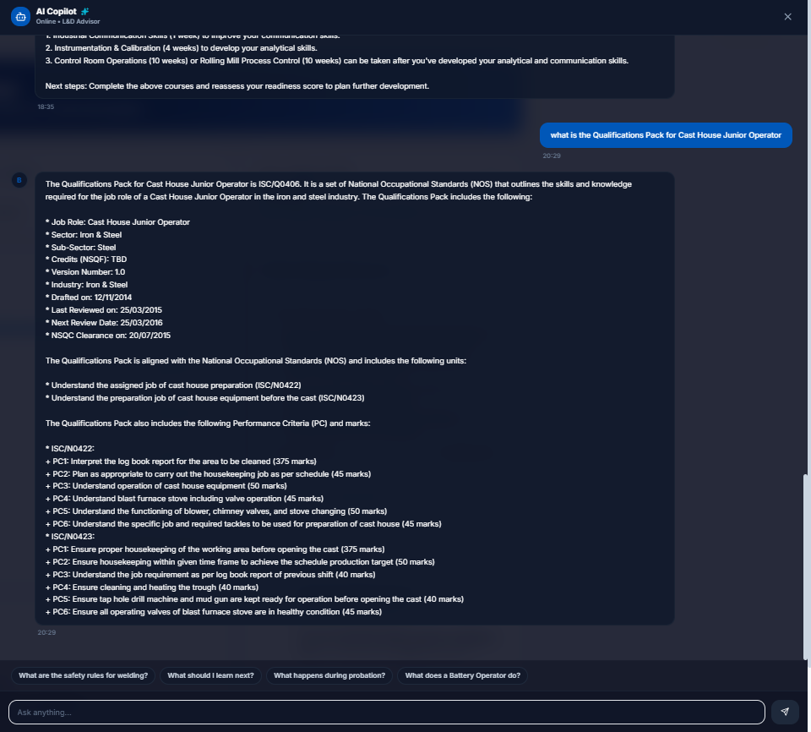
System Demonstration & Screenshots

